Slide 1
Process Review

Slide 2
Purpose
Process
Benefits
Notes:
What is OpenAgile?
How does OpenAgile work?
Why should your organization use OpenAgile?

Slide 3
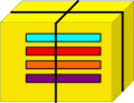
OpenAgile is a
Value Delivery System

Slide 4
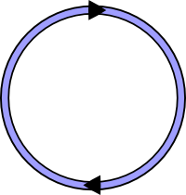
Work is Done in
Cycles

Slide 5
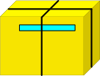
The Big Picture
Work
Cycle 1
GOAL
Notes:
Deliver valuable results at the end of every cycle
Work at a sustainable results
Cycles are also known as “sprint” or “iterations”

Slide 6
The Big Picture
Work
Cycle 1
Work
Cycle 2
Work
Cycle 3
Work
Cycle 4
GOAL
Notes:
Each cycle builds on the results of previous cycles.

Slide 7
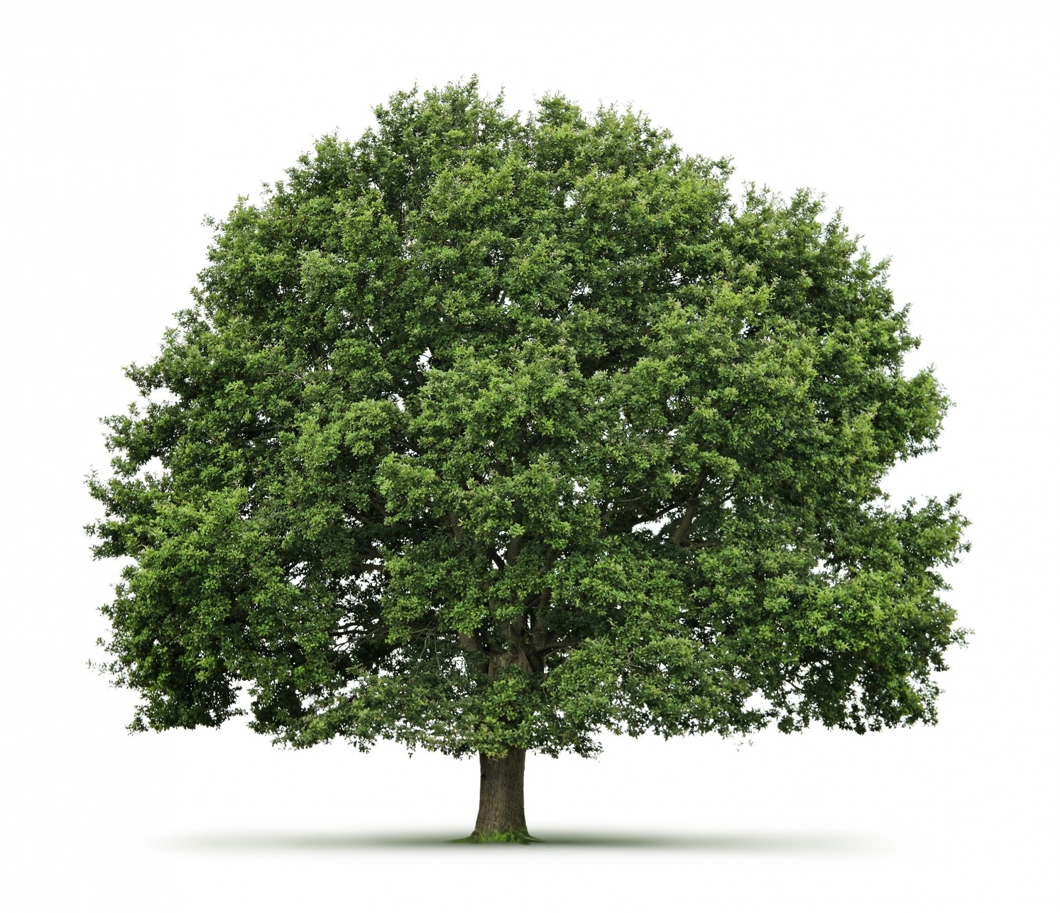
Organic Growth
Notes:
Responding to change
Folly of long-term planning

Slide 8
Value Drivers: Creation
INVEST
Notes:
Truthfulness is foundation of all human virtues.
Truthfulness is required to progress...
Other human capacities...
Volition
Detachment
Understanding
Vision

Slide 9
Value Driver
Prioritization
high
Priority 1
Value
med
low
Priority 100
low
med
high
Effort
Notes:
Truthfulness is foundation of all human virtues.
Truthfulness is required to progress...
Other human capacities...
Volition
Detachment
Understanding
Vision

Slide 10
Benefits
Notes:
Traspenrancy
Quality
Productivity
mprovement

Slide 11
O
Notes:
Any questions or comments?

